Slide 1

Explainable AI: Designing Domain-Specific Frameworks for Trust and Regulatory Compliance
Master's Thesis Review | AI Governance & Ethics

Slide 2
Thesis Roadmap
This presentation outlines our investigation into Explainable AI (XAI) frameworks that bridge the gap between model accuracy and interpretability. We address the urgent need for transparent AI systems in high-stakes domains where accountability, trust, and regulatory compliance are non-negotiable.
01
02
Define the Black-Box Problem
Validate XAI Solutions
Understand opacity, bias, and regulatory risks in deep learning.
Test bias detection and explainability techniques on real datasets.
03
04
Build Two Platforms
Demonstrate Impact
Enterprise audit tool and clinical decision support system.
Prove feasibility, scalability, and real-world applicability.

Slide 3

The Black-Box Crisis in AI
Deep learning models achieve remarkable accuracy, yet remain fundamentally opaque. This opacity creates three critical vulnerabilities:
Hidden Bias
Accountability Gap
Regulatory Risk
Discriminatory patterns embedded in training data propagate silently through predictions, affecting hiring, lending, and healthcare decisions.
When AI systems fail, organizations cannot explain why—leaving them vulnerable to legal liability and stakeholder distrust.
The EU AI Act, India's DPDP Bill, and emerging legislation mandate explainability. Non-compliance threatens market access and organizational legitimacy.

Slide 4

The Challenge
The Solution
The Outcome
Accuracy without explainability
Explainable AI (XAI)
Trust + Transparency + Compliance
Explainable AI bridges the interpretability-accuracy gap by making model decisions transparent, traceable, and justifiable to stakeholders. Our thesis designs domain-specific XAI frameworks that embed explainability into enterprise governance and clinical practice—transforming AI from a black box into a trusted partner.

Slide 5
Initial Exploration: Proof of Concept
We validated XAI techniques through two foundational experiments using public datasets and established libraries.
Usecases are Explainable Loan Approval , Sentiment Analysis
Experiment 1: Bias Detection
Experiment 2: Model Explainability
Applied Fairlearn to detect demographic bias in loan approval predictions. Identified systematic disparities across protected attributes and quantified fairness metrics.
Used SHAP and LIME to explain individual predictions in loan approval and sentiment analysis, revealing top contributing features and decision logic.
Dataset: Public financial + review data
Dataset: UCI Credit dataset
Tools: SHAP, LIME
Tool: Fairlearn bias detection
Output: Feature importance rankings
Finding: 18% approval disparity

Slide 6
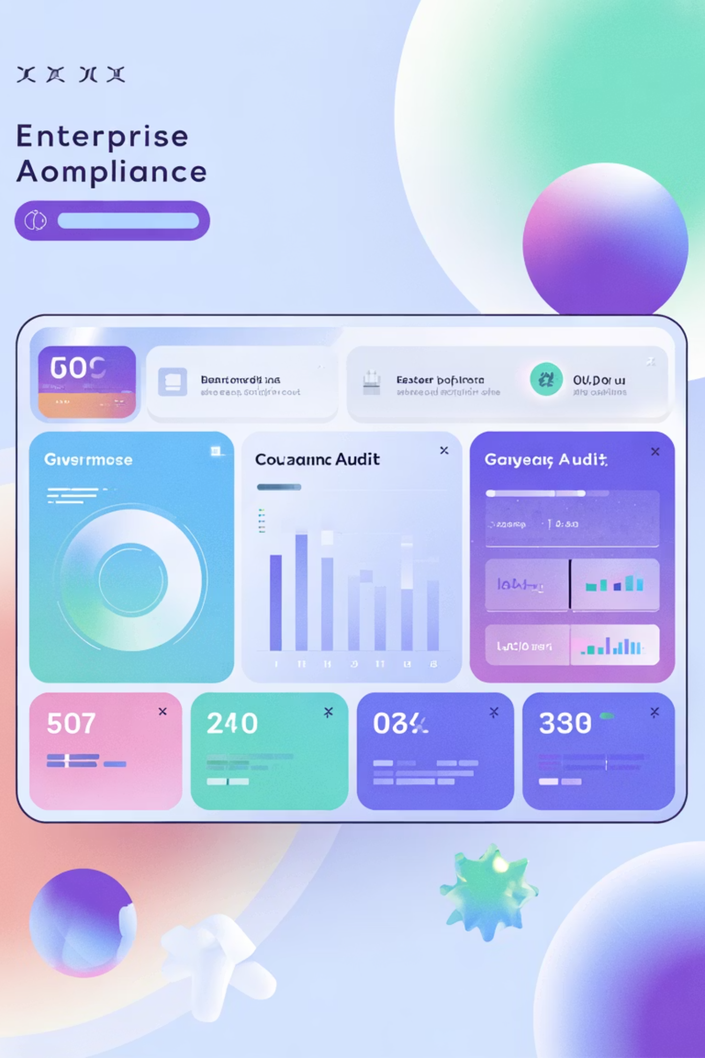
Project 1: X-Trust (Enterprise AI Audit Platform)
X-Trust is an automated compliance engine designed for organizations deploying high-risk AI systems. It provides real-time auditing, bias detection, and transparency reporting—turning governance from reactive to proactive.
Use Case
Core Value
Enterprise risk and compliance teams audit deployed AI models for bias, robustness, and regulatory adherence.
Automated Compliance Check Engine + Model Transparency Report (AI Audit Certificate).
Methods
Bias detection (Fairlearn), explainability (SHAP/LIME), robustness testing, performance monitoring.

Slide 7
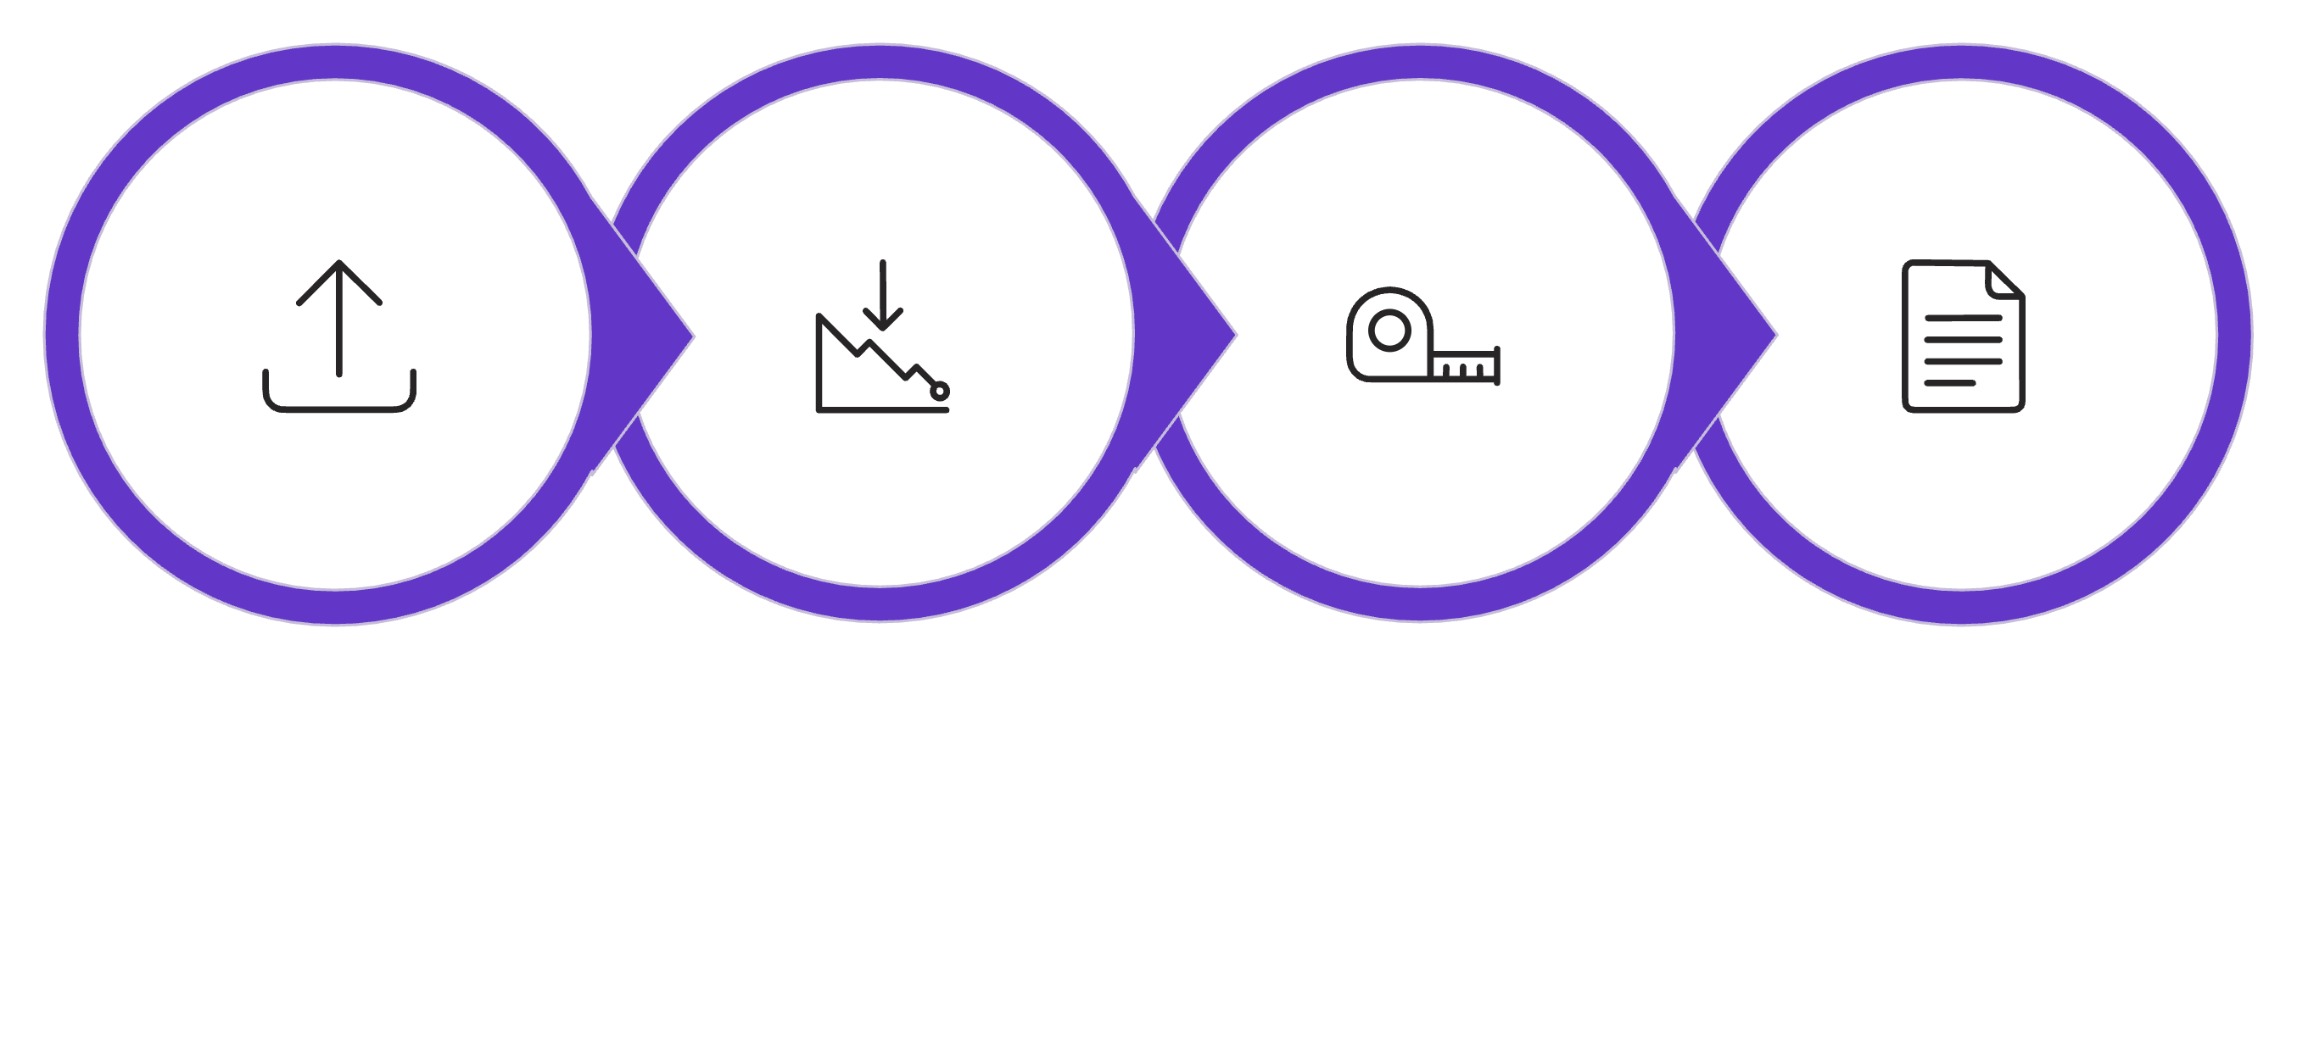

X-Trust: Technical Architecture
The platform follows a modular pipeline that transforms raw models into audited, compliant AI systems ready for deployment.
Upload Model
Automated Audit
Transpareny Report
Evaluation
Key Input: Pre-trained ML/DL model. Key Output: Comprehensive audit report with fairness scores, explanation dashboard, and compliance certification. Enterprise Impact: Reduces audit time from weeks to minutes while providing defensible documentation for regulators.

Slide 8

Project 2: MedExplain (Clinical Decision Support System)
MedExplain brings explainability to clinical AI, enabling physicians to understand and trust AI-generated diagnostic recommendations. It combines prediction accuracy with human-interpretable explanations rooted in patient-specific evidence.
Use Case
Core Value
Clinicians review AI-predicted disease likelihood alongside transparent, evidence-based explanations for clinical decision-making.
Prediction + Top 3 Contributing Factors (SHAP) + Interactive Visual Dashboard.
Societal Impact
Builds physician trust, improves diagnostic accuracy, enables evidence-based care, and ensures patient safety through transparency.

Slide 9
MedExplain: Workflow & Output
The MVP demonstrates how clinical explainability works end-to-end, from patient data ingestion through AI prediction to physician-friendly explanation.
AI Model Processing
Patient Data Input
Trained neural network computes disease probability and underlying decision factors.
Clinical variables (age, blood pressure, cholesterol, glucose levels, medical history).
Visual Dashboard Output
SHAP Explainability
Prediction score + interactive visualizations (Plotly/Streamlit) showing feature contributions, risk factors, and clinical context.
Identifies top 3 contributing features and their influence on the prediction (positive/negative impact).
Result: Physicians receive not just a prediction, but a justified, auditable clinical recommendation backed by patient-specific evidence.

Slide 10
Methodology, Tech Stack & Timeline
XAI Techniques: SHAP (SHapley Additive exPlanations) for global and local interpretability; LIME for model-agnostic local explanations; Fairlearn for bias quantification.
Technology Stack
Thesis 2: Next Steps
Languages: Python
Q1: Build X-Trust MVP, integrate audit modules
Libraries: scikit-learn, TensorFlow/PyTorch
Q2: Develop MedExplain interface, clinical validation
XAI Tools: SHAP, LIME, Fairlearn
Q3: End-to-end testing, performance optimization
Visualization: Plotly, Streamlit
Q4: Documentation, publication, thesis defense
Datasets: UCI Heart Disease, Diabetes, Credit (public)

Slide 11
THANK YOU

